Slide 1
E-commerce
Website and Mobile App (electro)

Slide 2
Project Team
Eslam Alaa Saber | Sara Mohammed Ghanem
Esmail Ekramy Esmail | Karim Nasr Saeed
Akram Hany Fekry | Hagar Farag Mohammed
Mohammed Essam AbdelHamid | Mohamed Khaled Mohamed
Eslam Gamal Saad | Rahma Hamada Attia
Under Supervision
Dr. Mohamed EL Araby | Dr. Doaa Lotfy
Eng. Hossam Fakher | Eng. Mohamed El ‎hakim

Slide 3

Introduction

Slide 4

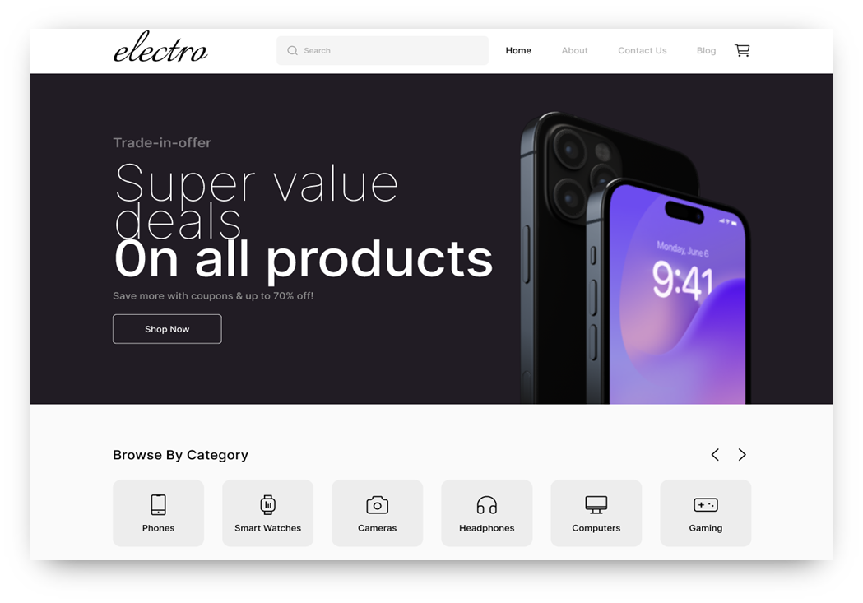

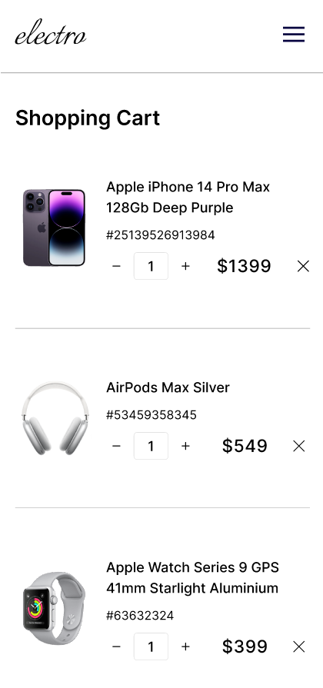




Project Overview
A modern e-commerce platform for seamless and secure online shopping, specializing in electronics like smartphones and laptops.
Built with React (Web),
.NET (Backend),
Kotlin (Android),
AI-powered recommendations, secure payments, order tracking, and advanced search & filtering.
This scalable solution enhances user experience while optimizing business efficiency.

Slide 5

Why E-commerce Market
The increasing demand for online shopping has led to a highly competitive market.
Many small businesses struggle with building a reliable and user-friendly e-commerce platform.
Common challenges include:
Poor user experience
Inefficient payment and logistics systems
Lack of personalized recommendations

Slide 6

Project Idea & Objectives
Idea: Develop an intuitive, scalable, and feature-rich e-commerce platform tailored to businesses of all sizes.
Objectives:
Provide a seamless online shopping experience.
Implement secure payment gateways.
Integrate AI-driven product recommendations.
Optimize logistics and order tracking.
Significance:
Enhances business reach and customer engagement.
Increases sales through data-driven insights.

Slide 7
Existing Solutions
Competitors:
Noon
Limitations of Existing Solutions:
Poor Web & Mobile Sync
Amazon
Complicated UI
Weak Search & Filtering

Slide 8
Our Solution & Innovations
✅ Specialized E-Commerce Platform for Electronics
🔹 How It Solves the Problem:
Seamless Cross-Platform Experience – Smooth transition between web & mobile.
User-Friendly Interface – Intuitive design for effortless shopping.
Advanced Search & Filtering – Find electronics easily by brand, price, specs.
Detailed Product Info – High-quality images, specs, and reviews for informed decisions.
Secure Transactions – Safe payments via Stripe, PayPal & strong authentication.
AI recommendation system - to improve the user experiences and same time of searching

Slide 9
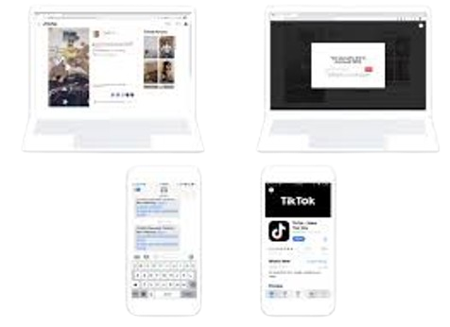
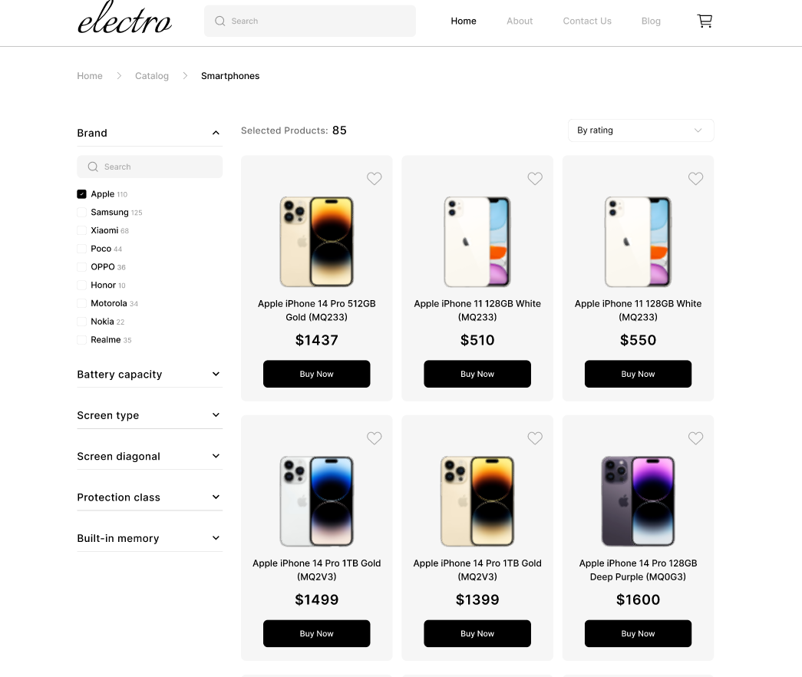
Seamless Cross-Platform Experience
User-Friendly Interface
9

Slide 10

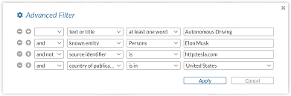
Advanced Search & Filtering
Secure Transactions
10

Slide 11

Technologies & Tools

Slide 12
Development Pipeline
Front-End
AI & Data Analysis
Back-End and Database
Mobile app
12

Slide 13
Front-End

Slide 14


Front-End
HTML - Structure of the app
CSS - Style and format
JavaScript - Dynamically
React.js – Web application development

Slide 15

Front-End Objectives
Objective: Build a responsive and user-friendly e-commerce web application.
Tech Stack Used:
HTML: Structure of the app.
CSS: Styling and formatting.
JavaScript: Adding interactivity and dynamic features.
React.js: Web application development.
Key Responsibilities: Implement UI components, enhance user experience, and ensure performance optimization.

Slide 16

Front-End Development Process
UI/UX Design: Developed a clean and modern interface using Tailwind CSS.
Component-Based Development: Used React.js to build reusable UI components.
State Management: Integrated Redux for managing global state efficiently.
Performance Optimization: Ensured fast loading and smooth navigation.
Cross-Browser Compatibility: Tested and optimized for various devices and browsers.

Slide 17
Key Features Implemented
Homepage & Navigation:
Responsive design with Tailwind CSS.
Dynamic navigation bar with category filters.
Product Display & Search:
Interactive product listing with sorting and filtering.
Search functionality with instant results.
Shopping Cart & Checkout:
Redux-powered cart for seamless item management.
Secure checkout integration.

Slide 18

Back-End

Slide 19




Back-End
.NET (C#) – Backend development
ASP.NET Web APIs (MC):
RESTful web service(Backend communication)
Entity Framework – ORM for database interactions
JWT (JSON Web Token) – Authentication & security

Slide 20

Design Patterns for ASP.NET Web APIs
a) Repository Pattern
Purpose: Separates data access logic from the business logic.‎
Benefits: Improves maintainability, testability, and reduces code duplication.‎
b) Unit of Work Pattern
Purpose: Manages database transactions efficiently, ensuring data consistency.‎
Usage: Typically used with the Repository Pattern.‎
20

Slide 21

Architecture Patterns for ASP.NET Web APIs
Layered Architecture (N-Tier) Structure:‎
i.‎ Presentation Layer (Controllers)‎
ii.‎ Business Logic Layer (Service Layer)‎
iii.‎ Data Access Layer (Repositories/EF Core)‎
iv.‎ Database Layer
Best for: Traditional enterprise applications.‎
Pros: Modular and easy to maintain.

Slide 22




Back-End Tools
Visual Studio
Swagger UI AND POSTMAN
Redis Manager
SQL Server management

Slide 23

Mobile

Slide 24

Mobile app objective
Why :
- More Users
- Better Experience
- Push Notifications
Objective: Build an efficient mobile shopping app and extract data-driven insights to improve user experience and sales.
24

Slide 25

Mobile Development Work
Tech Stack: Kotlin, Android Studio, and Retrofit
Key Features Developed:
User authentication & profile management.
Product browsing & search functionality.
Shopping cart & checkout system.
Order tracking & notifications.
Payment gateway integration.
Challenges & Solutions: (e.g., optimizing performance, handling API responses efficiently).

Slide 26
Mobile
Architecture Patterns
MVVM (Model-View-View Model)
The recommended pattern for Android.
Helps separate UI logic (View) from business logic (View Model).
Works well with Jetpack components like Live Data, View Model.
Design Patterns
Repository Pattern (Managing API Calls)
Centralizes data fetching logic (API, database, etc.).
Helps manage different data sources in a scalable way.
Singleton Pattern(Avoiding Redundant Object Creation)
Ensures a single instance of Retrofit, Database, etc.

Slide 27


Mobile Tools
Kotlin – Android app development
Retrofit – API communication
Android Studio - IDE

Slide 28

Data Analysis

Slide 29
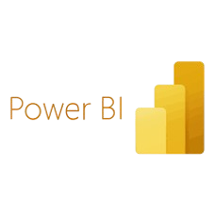




Data Analysis Tools
Excel – cleaning Data
Power BI – Data Visualization
SQL – Export Data
Numpy - Data preprocessing
Pandas - Data manipulation
Matplotlib - Data Visualization
29

Slide 30
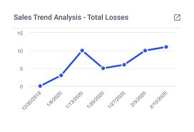
Project Overview
Objective: Understanding customer behavior, sales trends, and optimizing business strategies.
Scope: Analyzing sales data, customer demographics, product performance, and website engagement.
Data Sources: Order records, customer data, website analytics, and marketing reports.

Slide 31

Data Collection & Processing
Data Sources: CSV files, databases, API integrations (if applicable).
Data Cleaning: Handling missing values, duplicate records, and inconsistent formats.
Tools Used: Excel, SQL, Python (Pandas, NumPy), Power BI.

Slide 32

Key Insights & Findings
Sales Trends: Best-selling products, peak seasons, and revenue patterns.
Customer Behavior: Preferred categories, repeat customers, and average order value.
Website Performance: Traffic sources, bounce rates, and conversion rates.
Marketing Impact: Effectiveness of campaigns, ROI, and customer acquisition cost.

Slide 33
Recommendations & Business Impact
Inventory Management: Stock popular items, reduce underperforming products.
Customer Retention: Personalized offers, loyalty programs.
Marketing Strategy: Focus on high-ROI channels, optimize ad spend.
Website Optimization: Improve UX/UI to increase conversion rates.

Slide 34

AI Assistant

Slide 35

AI User Assistance System
In this part we aim to assist user by provide some AI system like (recommendation system, Chatbot and visual search) that will help to save user time and money.

Slide 36

Recommendation system
Recommendation system enhance user experience, increase user activity, and boost sales. These systems process large datasets to identify patterns and predict what a user might like next.
we can also improve recommendation accuracy by adapting to evolving user preferences.

Slide 37

Chatbot
chatbot provide personalized customer support by answering queries, assisting with product searches, and guiding users through the shopping process.
Chatbot also streamline order management by providing order tracking updates, processing returns, and handling cancellations. Additionally, they boost sales through conversational marketing, upselling, and cross-selling strategies.

Slide 38
Visual search
This technology uses computer vision and machine learning to analyze visual features like color, shape, and patterns to match products in the database.
It enhances user experience by making product discovery faster and more intuitive, especially for fashion, home decor, and accessories.
This feature reduces search friction, improves conversion rates, and enhances personalized shopping experiences.

Slide 39



AI Tools
Python – Programming Language
Colab – Environment
Kaggle – Datasets

Slide 40

System design

Slide 41
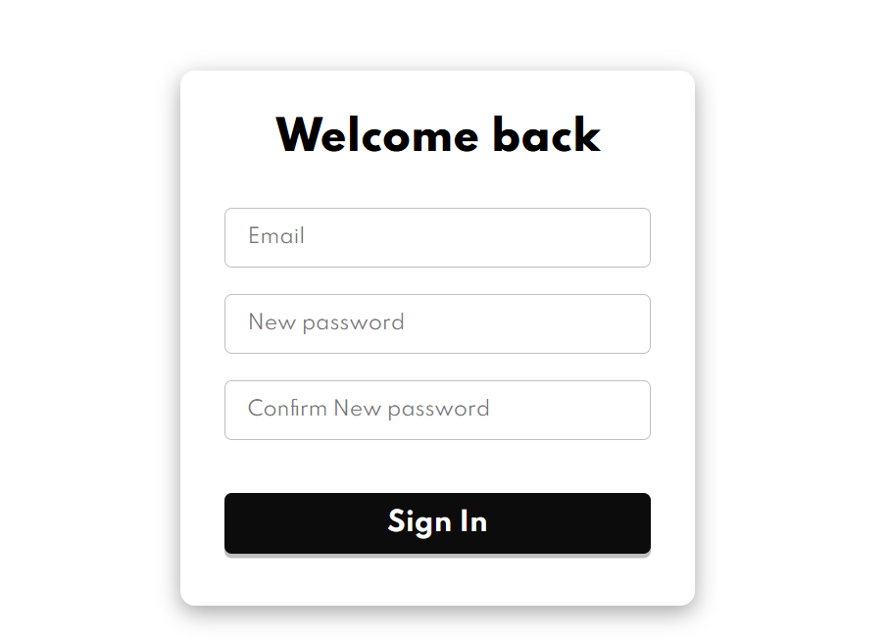
Sign up page

Slide 42
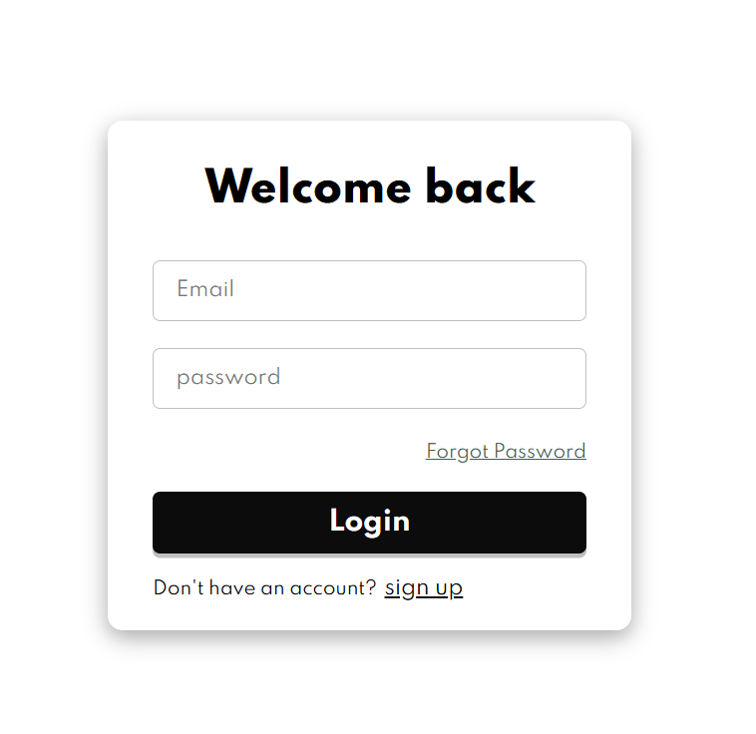
Login page

Slide 43
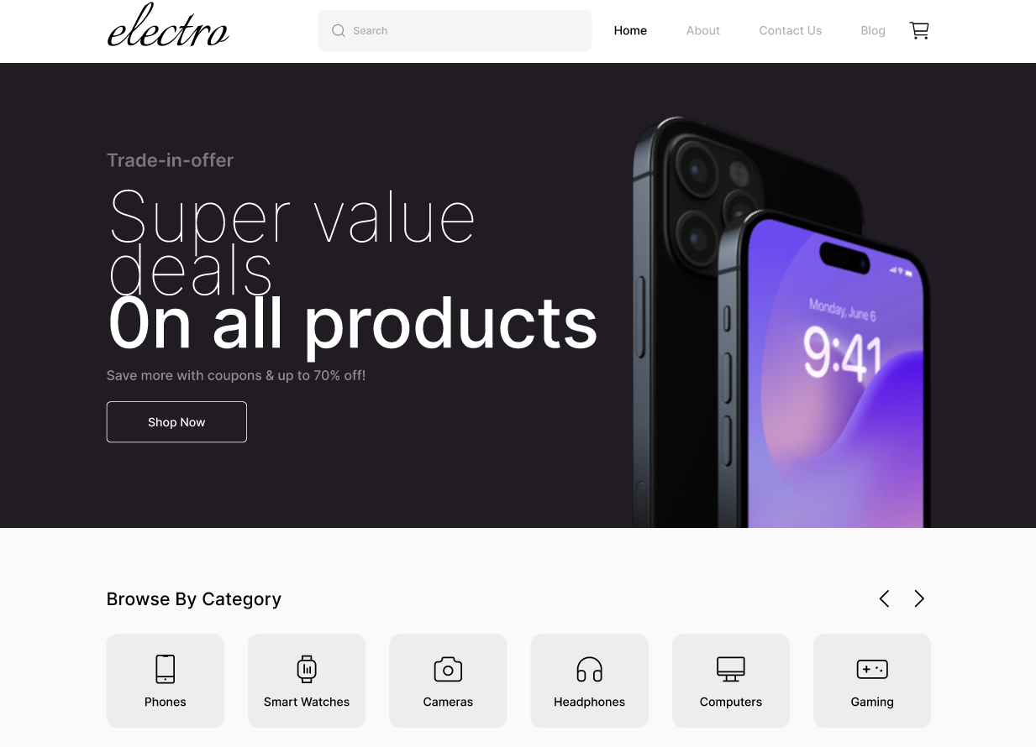
Home page

Slide 44
Product page

Slide 45
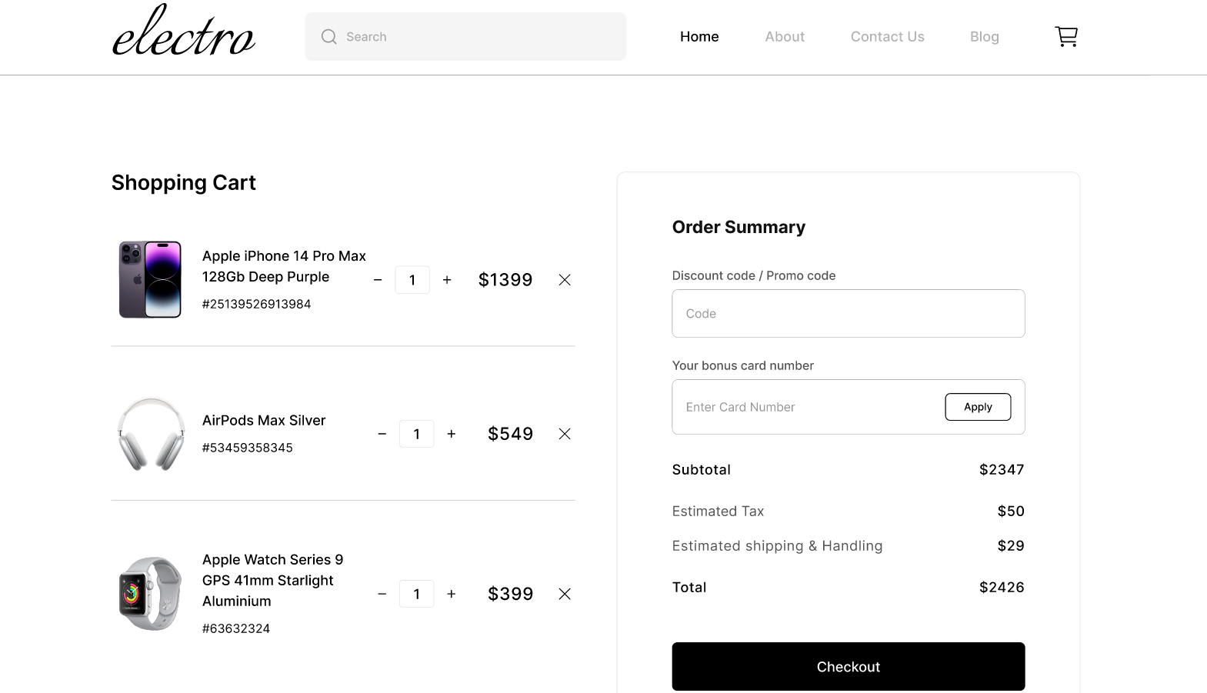
Cart page

Slide 46
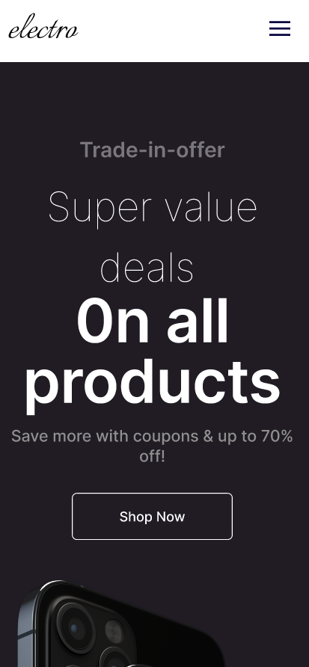
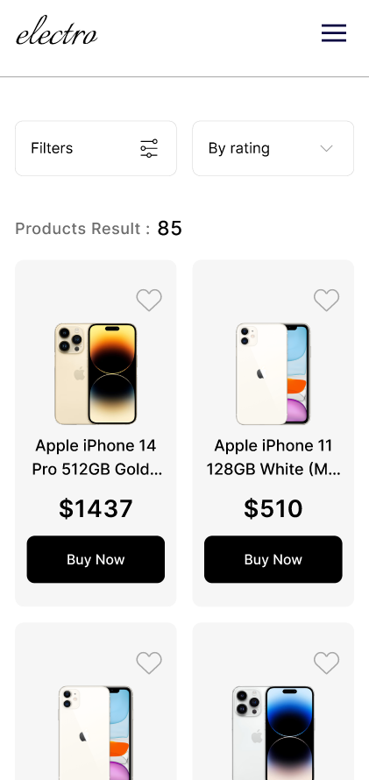
App design

Slide 47
Project Timeline
✅ Completed:
- System analysis & diagrams
- Defined project idea & problem
- Developed website & app frontend
🔄 In Progress:
- Backend integration
- AI recommendation system testing
⏳ Upcoming:
- Final security enhancements
- Multi-vendor support integration

Slide 48
Conclusion & Next Steps
The project aims to provide a robust, AI-powered e-commerce platform.
Current focus: completing backend integration and AI recommendation system.
Future plans: expand features, integrate multi-vendor support, and enhance security measures.

Slide 49
Thank you

